Slide 1
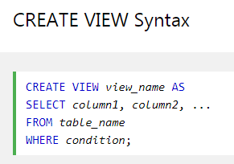
SQL Views
In SQL, a view is a virtual table based on the result-set of an SQL statement.
A view contains rows and columns, just like a real table. The fields in a view are fields from one or more real tables in the database.
You can add SQL functions, WHERE, and JOIN statements to a view and present the data as if the data were coming from one single table.
A view always shows up-to-date data! The database engine recreates the data, using the view's SQL statement, every time a user queries a view.
CREATE VIEW EmployeeAge20 AS
SELECT EMPLOYEE_NAME, AGE
FROM employee
WHERE AGE = 20;
SELECT * FROM EmployeeAge20;

Slide 2
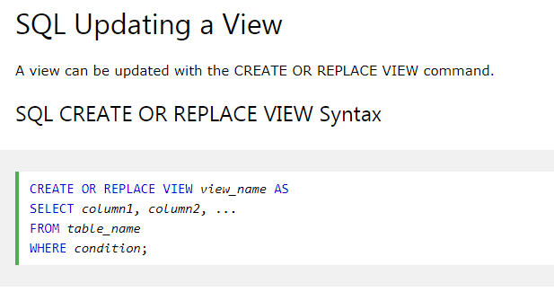
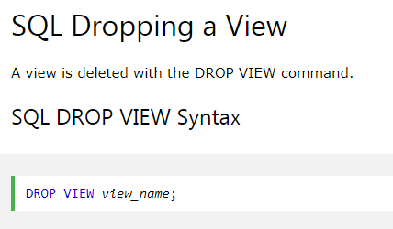
SQL Views
CREATE OR REPLACE VIEW EmployeeAge20 AS
SELECT EMPLOYEE_NAME, AGE, SALARY
FROM employee
WHERE AGE = 20;
DROP VIEW EmployeeAge20

